Slide 1


Lecture 14-1: Boosting
CSE445 Machine Learning
Dr. Jilan Samiuddin (JSA)
Assistant Professor
North South University

Slide 2
Introduction
Boosting is an ensemble learning technique that combines multiple weak classifiers to form a strong classifier
It works in a sequential manner, where each model is trained on the errors of the previous one
The process begins by training an initial model on the training data
The next model is built to correct the errors made by the first model
This sequence continues, adding models one after another, until:
All training data is classified correctly, or
A predefined number of iterations is completed
Boosting can be compared to a teacher who focuses more attention on students who are struggling, aiming to improve their academic performance — similarly, boosting focuses on the mistakes to improve the overall model

Slide 3
Ensemble Learning
Definition: Combining multiple base models to improve overall predictive performance
Core Idea: Diverse models make fewer errors collectively (a strong learner built from many weak learners)
Key Techniques:
Bagging (Bootstrap Aggregating)
Train models on different data subsets
Reduces variance (e.g. Random Forests)
Boosting
Sequentially train models, each focusing on previous errors
Reduces bias (e.g. AdaBoost, Gradient Boosting)

Slide 4
AdaBoost
AdaBoost (Adaptive Boosting) is a the most frequently used boosting algorithm that improves the performance of weak learners in a sequential manner
Initially, it assigns equal weights to all training samples, treating each datapoint as equally important
After training the first weak learner, the algorithm increases the weights of the misclassified samples
This ensures that the next learner focuses more on the difficult cases that were previously misclassified
The process continues iteratively, combining the outputs of multiple weak learners to form a strong classifier
AdaBoost effectively reduces both bias and variance, making it suitable for various classification tasks
However, it can be sensitive to noisy data and outliers, as these can receive disproportionately high weights during training

Slide 5
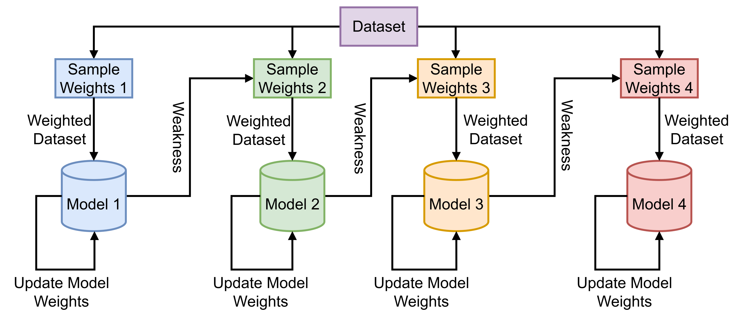
AdaBoost Algorithm
Initialize sample weights equally
Train the first weak learner on the weighted dataset
Evaluate its performance and compute the error rate (weighted sum of misclassified samples)
Update the model's weight
Update the sample weights:
Increase the weights of misclassified examples
Decrease the weights of correctly classified ones
Normalize the sample weights so they sum to 1
Repeat steps 2–6 for the next learner using the updated sample weights

Slide 6
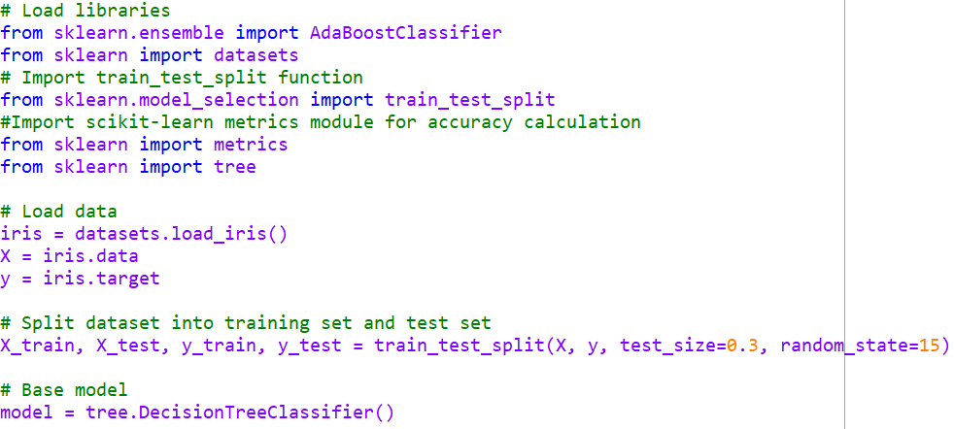
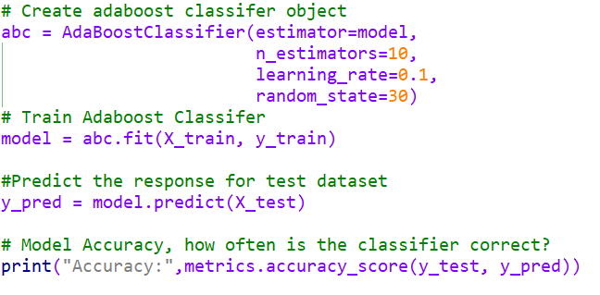
Python Code Example

Slide 7
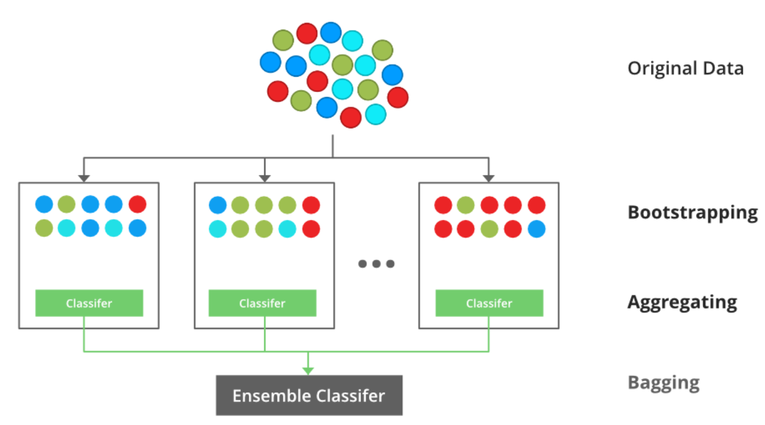
Bagging
Bagging Workflow
Bootstrap Sampling: Create several datasets of the same size as the original by randomly drawing observations with replacement
Model Training: Fit an individual base learner to each bootstrap sample
Parallel Learning: Train all base models independently and simultaneously on their respective samples
Prediction Aggregation: Combine the outputs of the trained models by majority vote for classification or by averaging for regression to produce the ensemble’s final prediction

